Slide 1
Introduction and Data Models

Slide 2
Introduction
Traditional Method of Storage
  Flat files maintained by the file system under operating system’s control.
  Data is stored in the form of records
  Record consists of various fields which are separated by a space, comma or tab
  Special characters to mark end of record and end of file.

Slide 3
Drawbacks of file system
  Data redundancy and inconsistency
  Difficulty in accessing data
  Data isolation
  Integrity problems
  Atomicity problems
  Concurrent access anomalies
  Security problems

Slide 4
Basic Definitions
Data: Known facts that can be recorded and have an implicit meaning.
Database: A collection of related data.
Metadata: data about data
Data dictionary

Slide 5
Basic Definitions
Database Management System (DBMS): A software package/ system to facilitate the creation and maintenance of a computerized database.
Database System: The DBMS software together with the database.

Slide 6
Data Abstraction
System to retrieve data efficiently led designer to use complex data structures to represent data
Developers hide complexity from user through levels of abstraction to simplify user interaction
A major purpose of a database system is to provide users with an abstract view of the data that is, the system hides certain details of how the data are stored and maintained.

Slide 7

View of Data

Slide 8
Levels of Abstraction
Physical level: describes how a record (e.g., customer) is stored.
Logical level: describes data stored in database, and the relationships among the data.
  type customer = record
  customer_id : string;
  customer_name : string;
  customer_street : string;
  customer_city : string;
        end;
View level: Many users of the database system do not need all information , instead they need to access only part of database. View level simplifies their interaction with the system.

Slide 9
Levels of Abstraction
struct customer{
char custid[10],
char *name,
char *city}
At physical level, record can be described as a block of
consecutive storage locations. The language compiler hides this
details from programmer. So the database system.
Application programs hide details of data types from users.

Slide 10
Instances and Schemas
Similar to types and variables in programming languages
Schema – the logical structure of the database
  Analogous to type information of a variable in a program
  Physical schema: database design at the physical level
  Logical schema: database design at the logical level
  Example: The database consists of information about a set of customers and accounts and the relationship between them
Instance – the actual content of the database at a particular point in time
  Analogous to the value of a variable

Slide 11
Data Independence
The ability to modify a schema definition in one level without affecting a schema definition in the next higher level
Physical Data Independence
– the ability to modify the physical schema without changing the logical schema
Logical data independence
– the ability to modify the logical schema without affecting application programs.

Slide 12
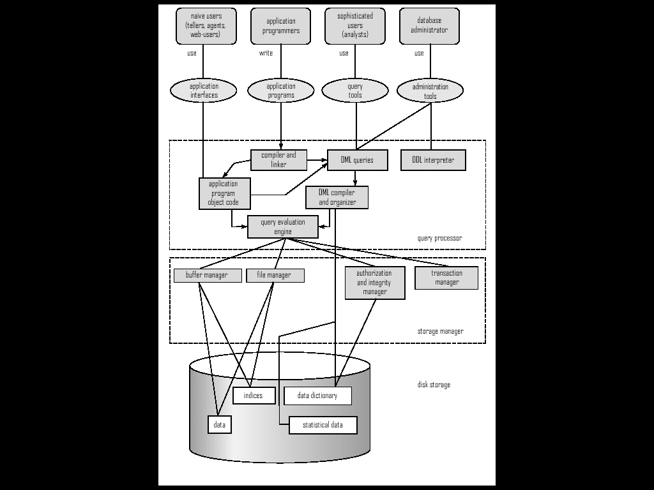
Overall System Structure

Slide 13
Storage Management
Storage manager is a program module that provides the interface between the low-level data stored in the database and the application programs and queries submitted to the system.
The storage manager is responsible to the following tasks:
  Interaction with the file manager
  Efficient storing, retrieving and updating of data

Slide 14
Transaction Management
A transaction is a collection of operations that performs a single logical function in a database application
Transaction-management component ensures that the database remains in a consistent (correct) state despite system failures (e.g., power failures and operating system crashes) and transaction failures.
Concurrency-control manager controls the interaction among the concurrent transactions, to ensure the consistency of the database.

Slide 15
Database Users
Users are differentiated by the way they expect to interact with
the system
Application programmers – interact with system through DML calls
Sophisticated users – form requests in a database query language
Specialized users – write specialized database applications that do not fit into the traditional data processing framework
Naïve users – invoke one of the permanent application programs that have been written previously
  Examples, people accessing database over the web, bank tellers, clerical staff

Slide 16
Database Administrator
Coordinates all the activities of the database system
  has a good understanding of the enterprise’s information resources and needs.
Database administrator's duties include:
  Storage structure and access method definition
  Schema and physical organization modification
  Granting users authority to access the database
  Backing up data
  Monitoring performance and responding to changes

Slide 17
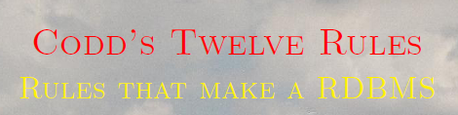
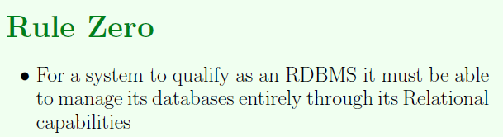
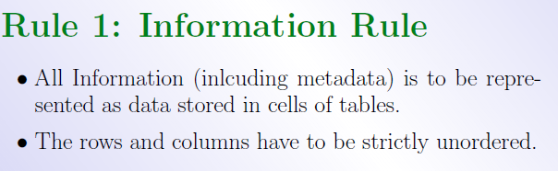

Slide 18
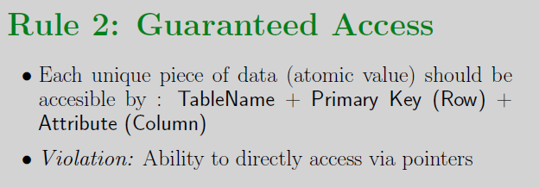
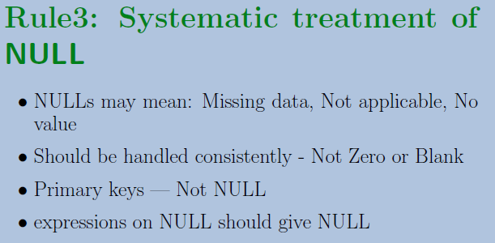
Codd’s Rules

Slide 19
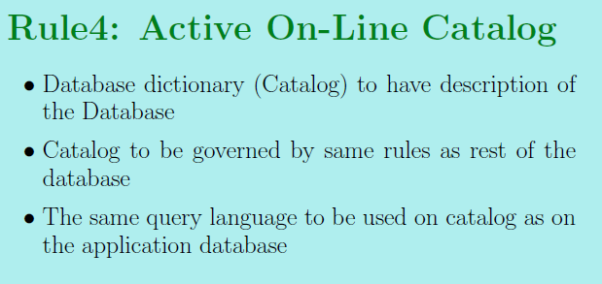
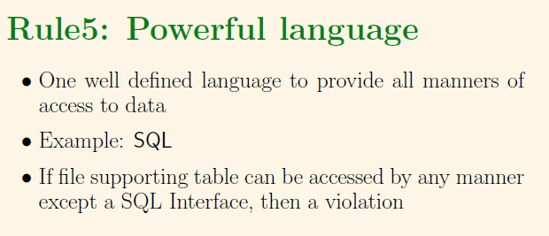
Codd’s Rules

Slide 20
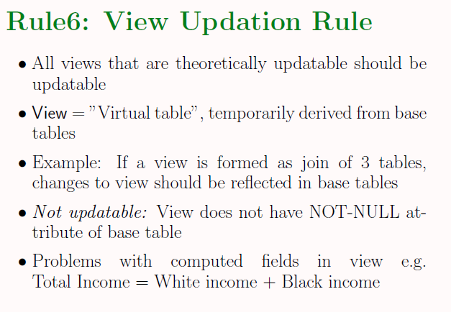
Codd’s Rules

Slide 21
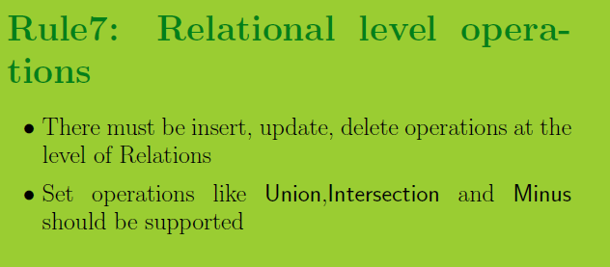
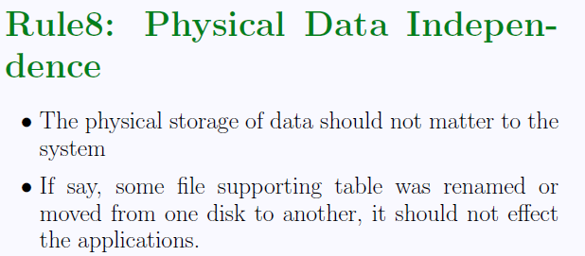
Codd’s Rules

Slide 22
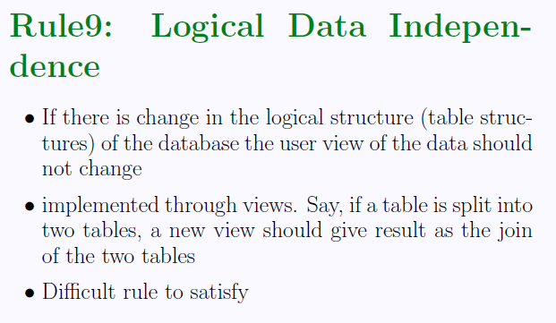
Codd’s Rules

Slide 23
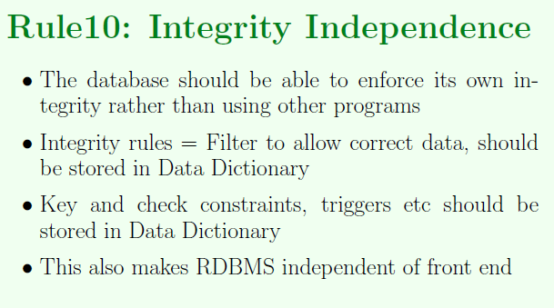
Codd’s Rules

Slide 24
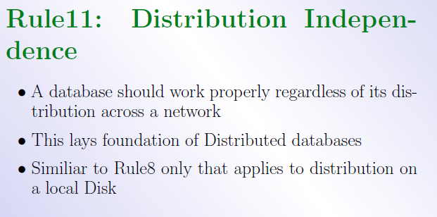
Codd’s Rules

Slide 25
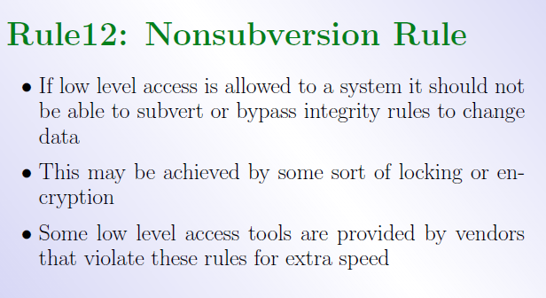
Codd’s Rules

Slide 26
Data Models
A collection of tools for describing
  Data
  Data relationships
  Data semantics
  Data constraints
Relational model
Entity-Relationship data model
Object-based data models (Object-oriented and Object-relational)
Semi-structured data model

Slide 27
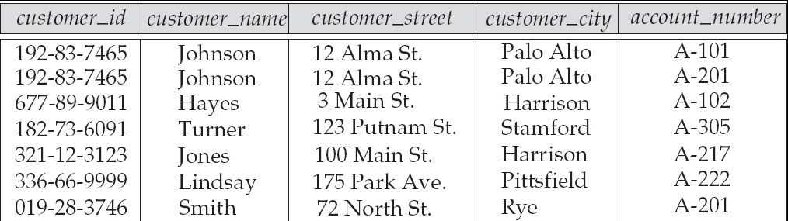
Relational Model
Attributes
Example of tabular data in the relational model

Slide 28

A Sample Relational Database

Slide 29

The Entity-Relationship Model
Models an enterprise as a collection of entities and relationships
  Entity: a “thing” or “object” in the enterprise that is distinguishable from other objects
    Described by a set of attributes
  Relationship: an association among several entities
Represented diagrammatically by an entity-relationship diagram:

Slide 30
Object-based Data Models
Object-oriented data model
  Extension to ER model with concept of encapsulation, functions and object identity.
  Database system that support an object oriented type system and allow direct access to data from an object-oriented programming language.
Object-relational data model
  Extend the relational data model by including object orientation and constructs to deal with added data types.
  Allow attributes of records to have complex types

